Slide 1
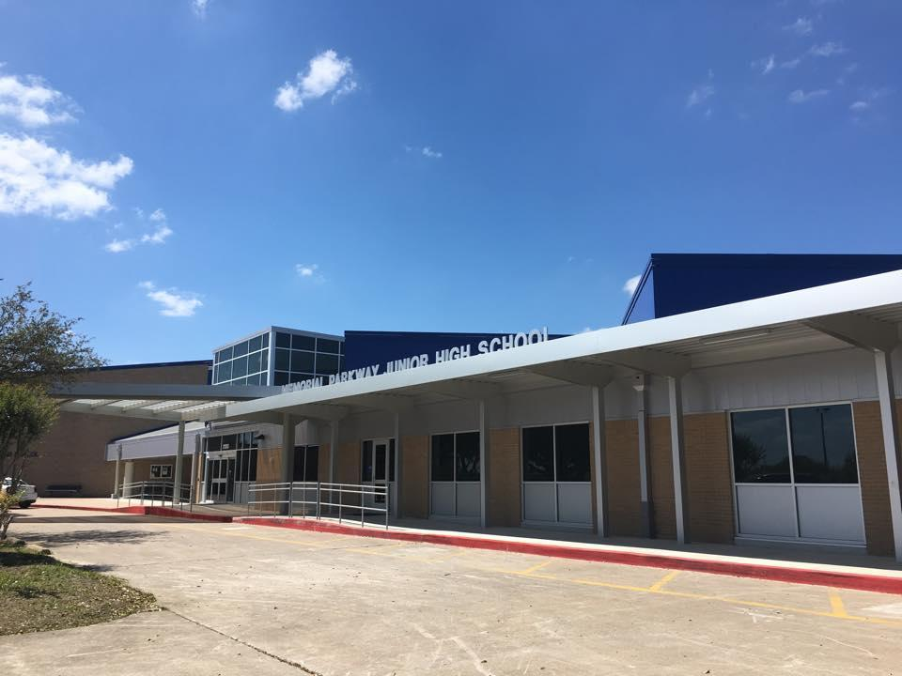
MPJH Course Selection
Incoming 8th grade
EAGLES ARE:
Trustworthy Accepting Leading Optimistic Noble Scholarly

Slide 2
Texas Top 10%
A student whose class rank* is in the top 10 percent of the graduating class may be eligible for automatic admission consideration at a Texas public college or university.
*Class rank must be based on the student’s rank at the end of the 11th grade, middle of 12th grade, or at high school graduation, whichever is most recent at the college or university’s application deadline.
A student in the Top 10% of the graduating class is eligible for automatic admission consideration at Texas public colleges and universities, with the exception of the University of Texas at Austin.
Students in the graduating classes of 2019 and 2020 who rank in the Top 6% of their class are eligible for automatic admissions consideration at the University of Texas at Austin.
Requirements to qualify for automatic admission consideration:
•Complete the FHSP + Endorsement, including the Distinguished Level of Achievement,
•Earn a satisfactory ACT or SAT score,
•Submit the application before the college or university’s deadline, and
•Provide a final high school transcript verifying completion of the FHSP + Endorsement, including the Distinguished Level of Achievement.

Slide 3
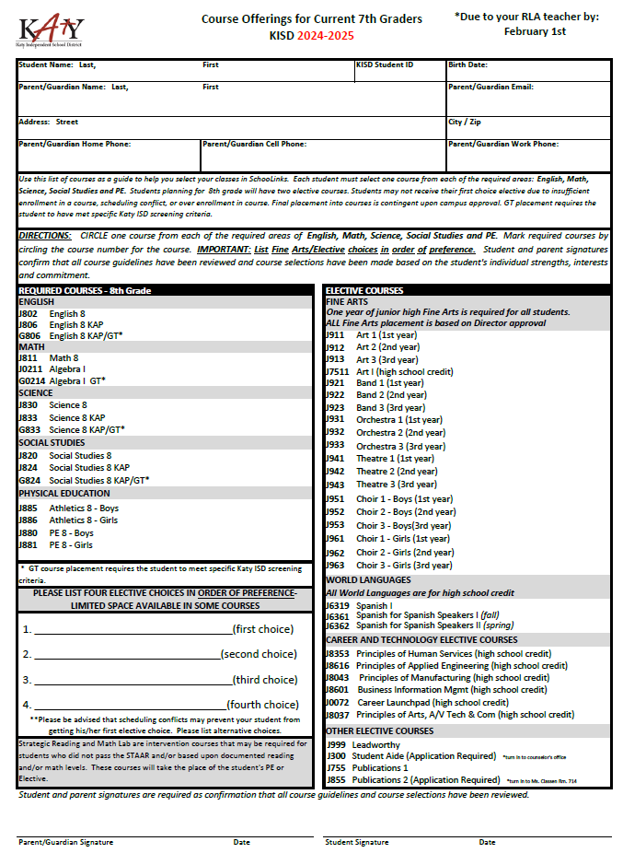
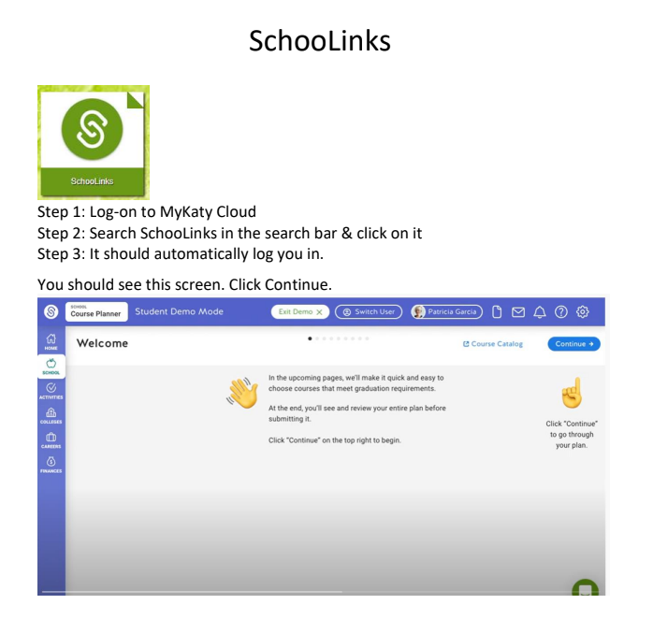
Course Selection Materials
Click Link and Watch SchooLinks Video
SchooLink Directions Video.mp4
You will enter courses in SchooLink again this year.
*Available on MPJH Counselors Website, Science & ELAR Canvas Page

Slide 4
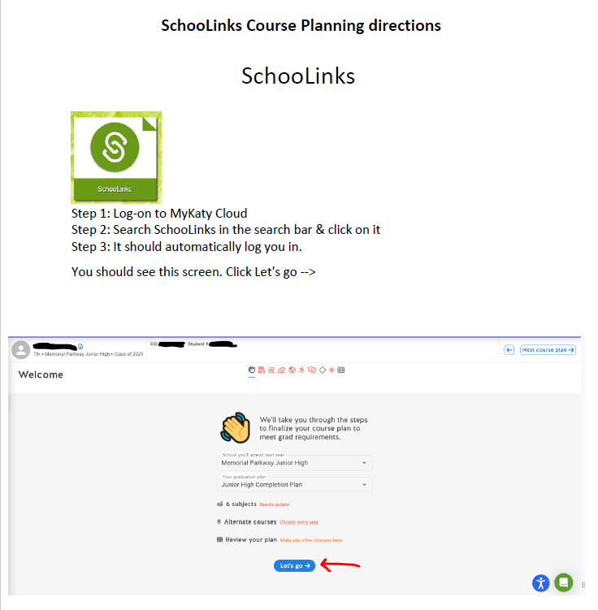

Slide 5
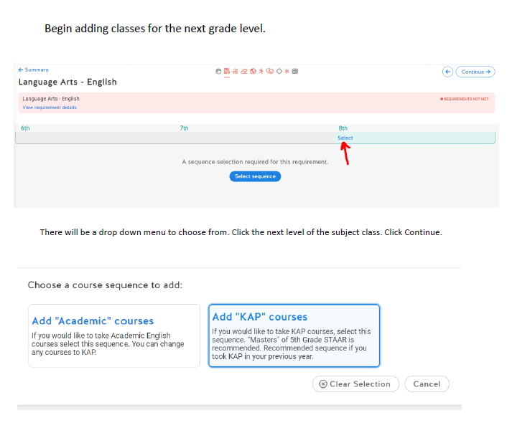

Slide 6
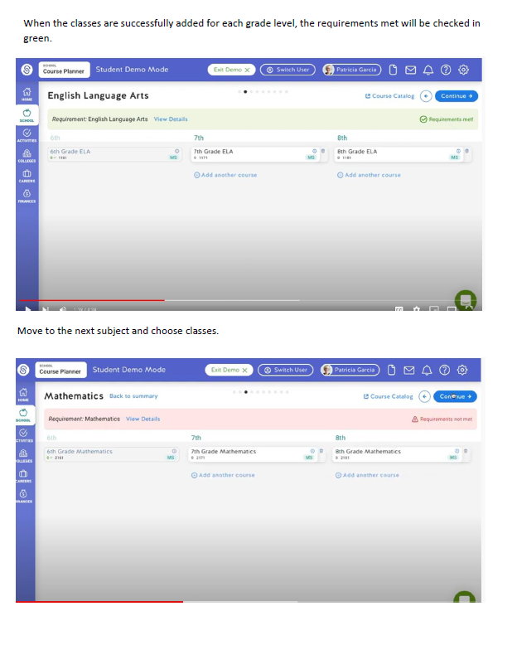

Slide 7
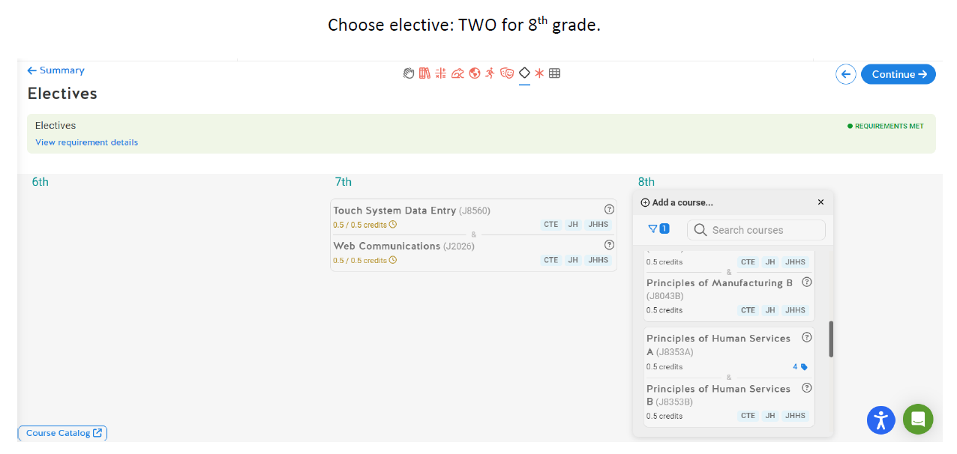

Slide 8
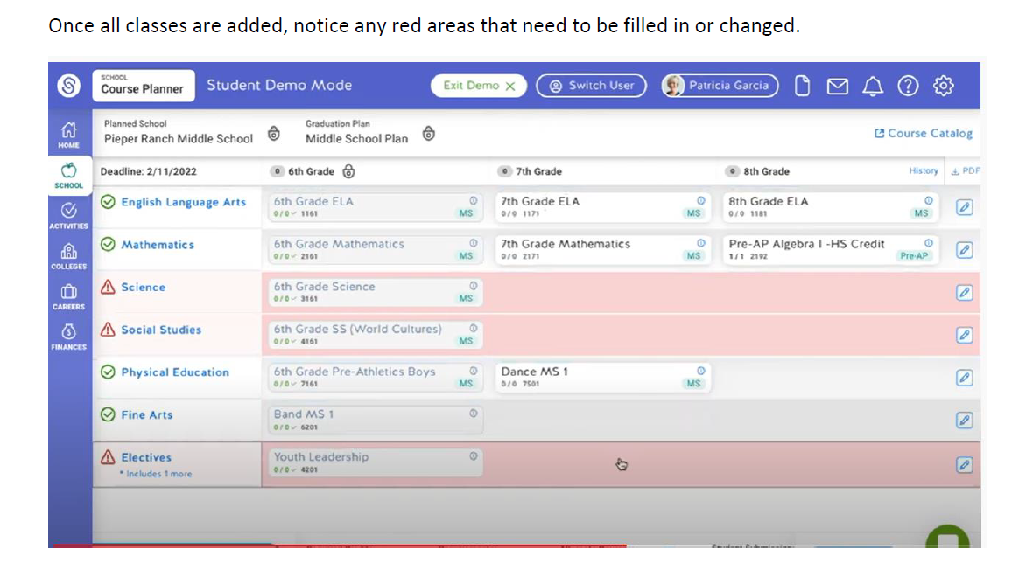
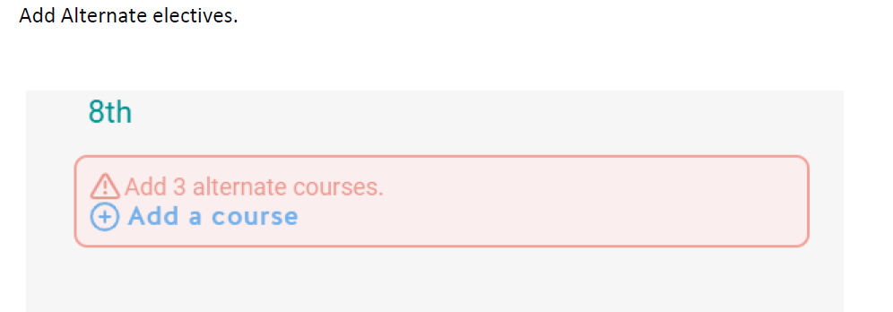

Slide 9
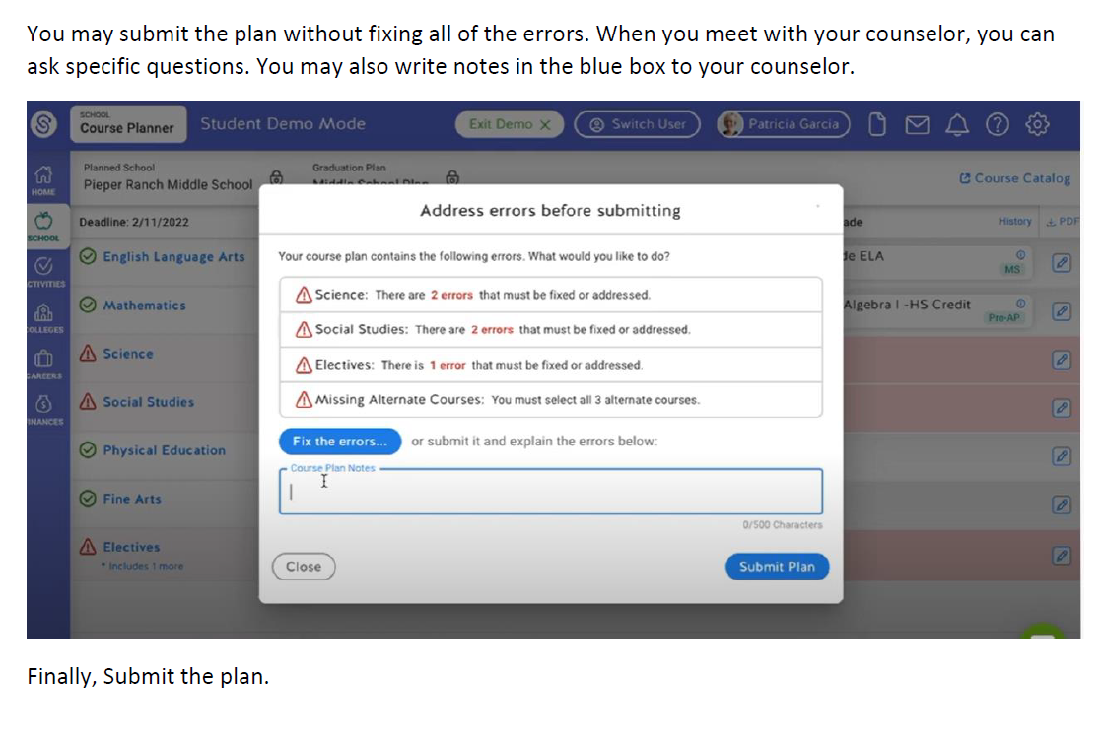

Slide 10
Three Class Formats
Academic – For everyone, on grade level, more time to review concepts, more tutoring provided, prepares students for college as well as other post secondary education
KAP (Katy Advanced Program - formerly called Pre-AP)– More challenging, faster pace, requires independent learning, prepares students for AP classes in high school *Recommend current average of 85 or higher in specific subject grade
GT – Must be currently screened and identified

Slide 11
Academic Math or High school Algebra
All 8th grade students will take 8th grade Academic Math. KAP math is not offered in the 8th grade.
Exceptions:
7th grade KAP math students who end the year with 70 or higher will be placed in High School Algebra.
7th grade academic students who take the 8th grade math CBE during the summer & pass with 80% or high can be placed in Algebra.
Current 7th Grade Algebra students will be placed in Geometry

Slide 12
Academic vs KAP English & Reading
KAP/AP courses are designed to challenge motivated students and prepare them for success in college level coursework in high school and beyond. These advanced or above grade-level courses move at a faster pace, are more academically challenging and require more independent learning than academic courses.
All students in junior high school ELA have the same curriculum.

Slide 13
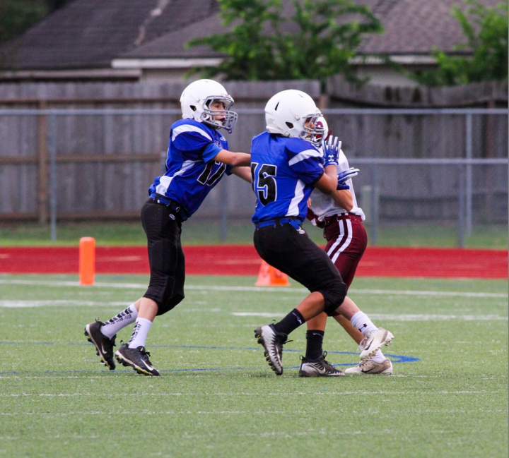
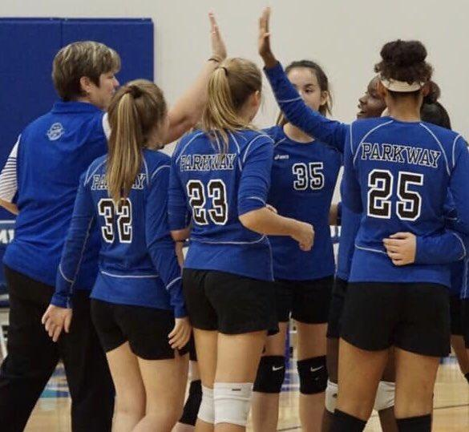
PE vs. Athletics
Based on tryouts during the 7th grade school year.
Coaches determine placement into athletics
Must have Physical on file dated after May 1, 2024 & Rankone online forms completed.
Athletic period sports:
Football,
Volleyball,
Basketball,
After school sports:
Soccer
Track
Tennis

Slide 14
Strategic Reading and Math Lab
Students who are unsuccessful on the STAAR in Math and/or Reading this Spring may be placed in a Math Lab or Reading Improvement class. These classes will replace an elective and/or PE.
Small class sizes 15:1 ratio to provide support in Math or Reading

Slide 15
Peer Assistance Leadership (PAL)
The Peer Assistance Leadership (PAL) program teaches students how to use their potential to make a difference with peers, schools and communities. This course nurtures and builds capacities to help youth increase resiliency and build protective factors to help them achieve school and social successes which lead to a productive life. Students participate in productive pursuits with peers and community members, using decision making, higher order thinking skills, and resiliency building.
Students must fill out an application and/or be nominated for this program/course and then wait for an approval/selection letter.
Enrollment notes: It is strongly recommended that students entering the PAL program successfully complete a LeadWorthy class prior to entering this class. Students may be required to purchase a shirt.
Qualities of PALs:
Self-motivation
Honesty
Dependability
Non-judgmental character
Leadership shown through positive lifestyle
Genuine concern for the welfare of others
Willingness to listen to others
Self confidence
Ability to work with a minimum of supervision

Slide 16
Non High School Credit Electives
Art: This course studies the visual arts, including painting, sculpture and architecture. Related problems in drawing and design allow creative application and extension of art materials and tools. Participation in regional and local exhibitions is part of the visual experience of the program.
Band: Students listen to a variety of instrumental musical styles as they learn basic elements of music including rhythm, pitch and music symbols. Students receive small group instruction organized by the instruments which they play. Concerts and music contests are a part of the band program.
Orchestra: Students listen to a variety of string musical styles as they learn basic elements of music including rhythm, pitch and music symbols. Concerts and music contests are a part of the orchestra program.
Choir: The choir sings a variety of music and presents several concerts during the year including participation in UIL music evaluations. Choir members have the opportunity to participate in Honor Choir, Region Choir and Solo Contest. The music sung is varied and ranges from classical to popular.
Theatre: This course includes an introduction to and development of expression, acting skills, theatre production and the history and appreciation of theatrical events.
Dance: Dance students gain fundamental knowledge of dance steps and terminology, music and choreography as they create and participate in dance combinations and performances. NOTE: Counts as the third year P.E. requirement. Course may not available at all campuses.
LeadWorthy: This course helps students develop leadership and personal and business skills as they learn to be responsible members of their community.
Publications: Students apply writing skills to the publication of the school yearbook. (application required)
Student Aide: This school service opportunity allows students work in school offices. Interested students who receive teacher recommendation will be placed as aides on an as-needed basis. (application required)

Slide 17
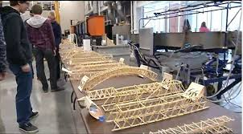
High School Credit Electives
Principles of Human Services: Students gain personal life management skills as they investigate human services careers, including counseling and mental health, early childhood development, family and community and personal care services. Topics include nutrition and dietary practices, food preparation, budgeting and management of family housing needs.
Principles of Applied Engineering: Provides an overview of the various fields of science, technology, engineering, and math and their interrelationships. Students will use multiple software applications to prepare and present course assignments along with hands-on projects.
Principles of Manufacturing: This course is a hands-on study of manufacturing technology. Students reinforce, apply and transfer academic knowledge and skills to a variety of activities, problems and settings, as students develop skills in the application, design, production, and assessment of products, services and systems and how these skills are applied to manufacturing.
Spanish I (High School Spanish I): One Students are introduced to Spanish and Hispanic culture while communicating in multiple modes and engaging in a variety of performance tasks.
Only Students that are tested for this level of Spanish can register
Spanish for Spanish Speakers I - (fall semester) Spanish for Spanish Speakers II - (spring semester) One credit per course. This is an introductory course for native and heritage language learners who already possess developed oral language skills. Students will continue to develop their language skills and increase their proficiency level.
Student may not be dually enrolled in Applied Engineering and Manufacturing.

Slide 18
High School Credit Electives
NEW THIS YEAR!!!
Career Launchpad: The goal of this project-based course is to give students an opportunity to become familiar with the different CTE programs offered by Katy ISD during high school. It will be a rotation of the programs to help students have a better understanding of what each course has to offer, so they are able to make informed decisions during their high school course selection/planning process.
Business Information Management: Students learn computer skill essentials for college and work readiness using the industry standard Microsoft Office Suite. Students produce a variety of Word documents create Excel spreadsheets and charts, develop and maintain Access databases, and design professional PowerPoint presentations. Outlook is introduced as a necessary skill in college and work. There are two programs of study in this cluster (Accounting & Financial services and Business Management)
Principles of Arts, A/V Technology, & Communications: This course will introduce students to careers in the Arts, Audio/Video Technology and Communications career cluster. Students will develop an understanding of various career opportunities in this cluster and the knowledge, skills, and educational requirements for those careers. There are 6 programs of study in this cluster (Audio Production, Video Production, Commercial Photography, Graphic Design, Animation, Fashion Design)

Slide 19
Dropping A High School Credit Class
Katy ISD Policy for Dropping High School Credit Courses
End of 1st Six Weeks: Any student with a failing grade will automatically be removed from the HS credit class & the grade WILL NOT be recorded on the HS transcript/GPA.
The ONLY time a student can request to exit a HS credit course is during the 1st six weeks!
End of the 2nd Six Weeks: Any student with a failing grade will automatically be removed from the HS credit class & the grade WILL NOT be recorded on the HS transcript/GPA.
This is the last time an automatic drop will occur until the end of the 1st semester.
3rd Six Weeks: Any student that is failing during this time will remain in the class until the end of the semester. The teacher will work with the student to bring their grade up.
End of 1st Semester: Any student that ends the 1st semester with a failing grade will be removed from the class. The grade WILL BE recorded on the HS transcript/GPA.
NO drops will occur any time during the 2nd semester!

Slide 20
Dropping A High School Credit Class
If a student tries to drop a high school credit class after progress report of the 1st six weeks because he/she is failing, the student will lose eligibility for UIL purposes.
If a student is failing after the 2nd six weeks, parents must sign the form if they wish for students to remain in a high school credit class. By signing the form, parents agree that the school is recommending that they switch electives (to avoid hurting high school GPA). The student will remain in the class for the rest of the semester and the grade will be recorded on the student's transcript.

Slide 21
Completing Course Selection Sheet
Legal first and last name
Circle level of core classes (Aca, KAP, KAP/GT)
LIST 4 ELECTIVES COURSE CHOICES IN ORDER OF PREFERENCE
Parent & student signature needed
Parent & student must also read the back of the course selection sheet
ENTER COURSES IN SCHOOLINKS!!!
Return course selection worksheet to your RLA Teacher by February 1st.
J8043 Prin of Manu
J8601 Bus. Info Mgt
J0072 Career Launch
J999 LeadWorthy
Evan Brown 1/30/2024
Eva Brown 1/30/2024

Slide 22
After today...
Turn in Course Selection Worksheet to your RLA Teacher by Feb 1st.
One-on-One with Counselor will be February 5th - 9th in all RLA classes.
Course Verification Letters will be in SchooLinks and all corrections will be submitted through comments in SchooLinks
THIS IS NOT A SCHEDULE!!!
Follow instructions for how to make changes on the course verification sheet.
Course Selection Timeline: Will be on the Counselors’ Page online, Science, & RLA Canvas pages.
All links are listed on timeline.

